Slide 1

Microwave Based Wireless Communication for NTN: A Thorough Investigation Using Simulation Based Model
Hussam Abdellatif | Ph.D. Candidate Master Thesis Defense – July 2025
Advisor: Dr. Josep M. Jornet
Committee: Dr. Dimitrios Koutsonikolas, Dr. Testolina, Paolo

Slide 2
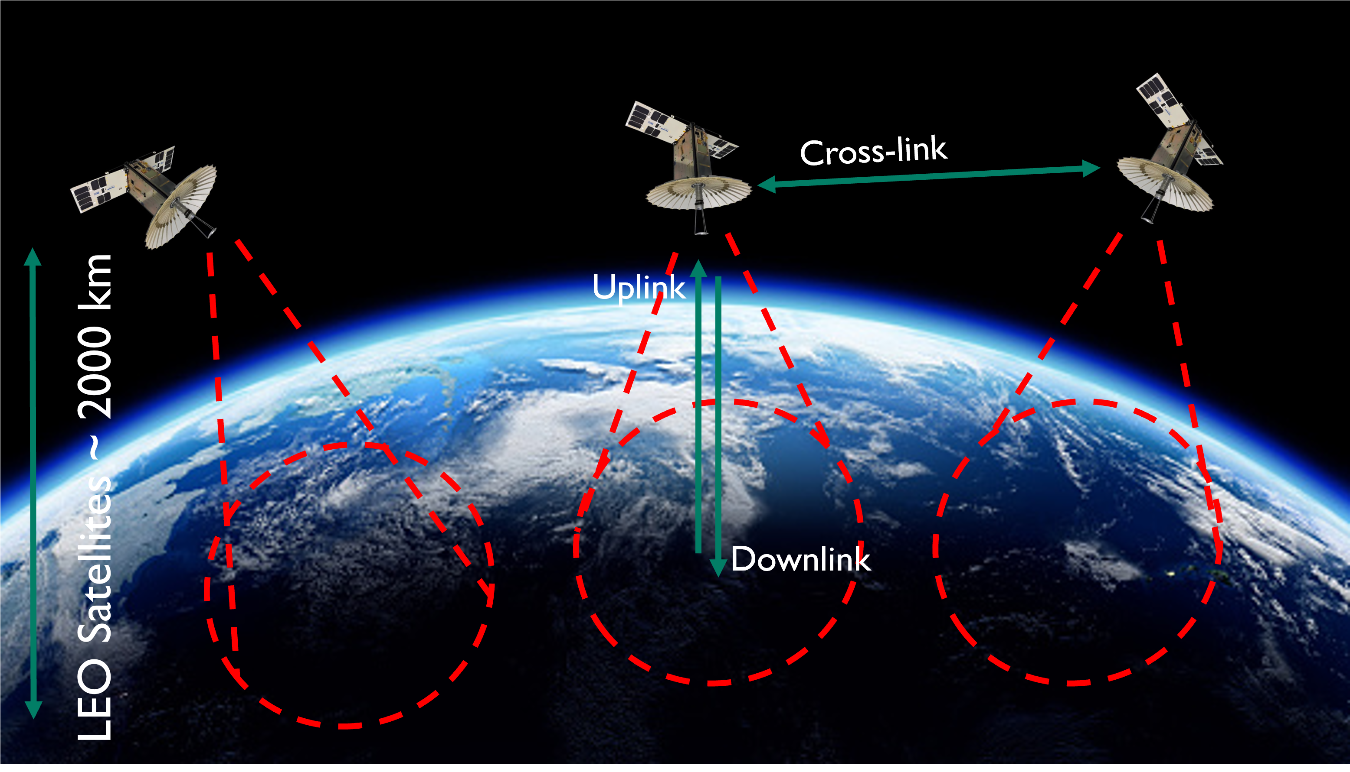
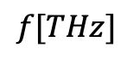
NTN: Utilizing Satellite Networks For Wireless Communication
Candidates For High-Speed Links (UL,DL,CL)
mmWave - [Ka, V] Offers a balanced trade-off between bandwidth, transmission distance, and alignment requirements.
THz Provides extremely high bandwidth, but with moderate range and more demanding alignment precision.
Optics Delivers the highest bandwidth, but demands precise alignment and is sensitive to atmospheric conditions
0.01
0.1
180
1500
$$f[THz]$$
Notes:
This presentation is split into 2 categories:
Physical Layer
MAC Layey
Two essential elements in the OSI Stack ..
In terms of the physical Layer we present 2 solutions:
Hyprid
Digital Domain imp
The PHY layer
The Analog Domain
Digital {Future Work}
High Speed D/c
Digital Impl.
MAC
Utilizing reflective Surfaces for NLoS

Slide 3
NTN: Motivation Behind Satellite Based Communication
Medium Access Channel (MAC) Protocol
Latency
Global Coverage
LEO massive constellations allow for wireless based networks
Dynamic/Robust
Wireless Based Links [Routing]
Less Congestion
Large constellations allow for more global coverage:
Remote/Rural Areas
Damaged Ground Infrastructure [emergencies]
Sub-THz Software-Defined Radio (SDR) Implementation
Throughput
Service Cost
Channel/Link condition allow for high frequency usage
Access to more bandwidth
Less Congestion
Frequency Reuse
Satellite constellations can serve more users
Lower Service Cost at Scale
Unified NW Provider [Global]
Digital / Analog Hybrid Solution
8/10/20 GHz Options
Notes:
Backbone maps: Mapping the Internet - ITGS News

Slide 4
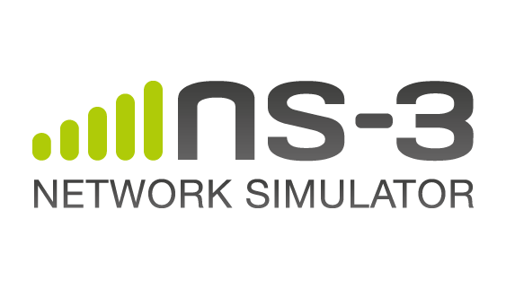


NTN: Simulators*
Medium Access Channel (MAC) Protocol
STK: Systems Tool Kit
NS-3 LEO Extension
Satellite Toolbox
Sub-THz Software-Defined Radio (SDR) Implementation
Released On 2022
Built on Top of NS-3
C++ [not a dominant language in research]
Contains Vast Communication-Based Modules/Ips
Free/Open-Source
Released On ~2021
MATLAB Based
Less Learning Curve
Simple and Powerful
Released On 1989
Industry Standard For Satellite Simulations/Analysis
License Required ($$$)
Complex Tool
Not Open-Source
Difficult To Adapt In Research Settings
Digital / Analog Hybrid Solution
8/10/20 GHz Options
* Disclaimer: This Project Was Completed in 2020. At the time, STK was the main (and one of very few) satellite simulator

Slide 5






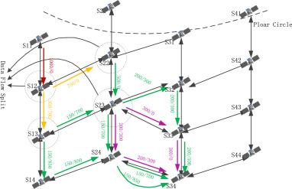

Our Work: In-House NTN Simulator
Medium Access Channel (MAC) Protocol
Goal
Develop an NTN Simulator
Fully Capture Satellite Characteristics
Orbital Parameters
Real-Time Movement/Orientation
Field of View
Develop NTN Based Link Budget
mmWave
THz Band
Satellite Constellations and Routing
Sub-THz Software-Defined Radio (SDR) Implementation
TLE
Digital / Analog Hybrid Solution
8/10/20 GHz Options
Notes:
An All-Programmable 16-nm RFSoC for Digital-RF Communications | IEEE Journals & Magazine | IEEE Xplore

Slide 6
Simulator Architecture
Medium Access Channel (MAC) Protocol
Begin Simulation
Find Suitable UL LINK
[GS → SAT]
Find CL Route
[SAT → SAT]
Find Suitable DL LINK
[SAT → GS]
RFSoC: ZU28DR GEN 1
Simulation
Environment
Loop Over Generated Transmission Instances
Technology
16-nm FinFET
time [i]
Sub-THz Software-Defined Radio (SDR) Implementation
Compute Satellite Coordinates
Compute Satellite CL [shortest hop]
Compute SNR, Data Rate, Latency
RF
8 DACs , 8 ADCs
Alternative
JESD to Ext.
Programmable Logic
DSP{4K}, LUTS{930k}
Compute Satellite Orbital Parameters (for each Satellite)
Grab Weather Conditions From API For Each Ground Station
Setup RF Parameters and Channel
Processing System
ARM A53, ARM R5
Application
mmWave
Digital / Analog Hybrid Solution
8/10/20 GHz Options
Load Satellite Constellation From TLE
Setup Ground Stations
Setup Timing

Slide 7
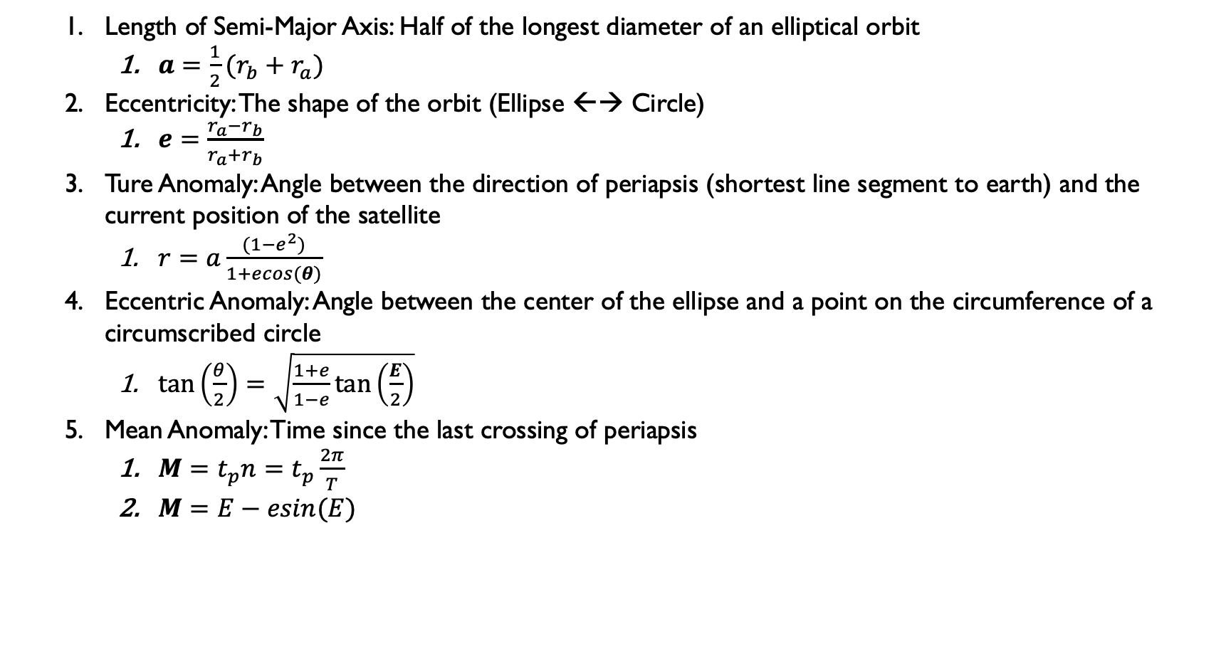
Orbital Parameters
Medium Access Channel (MAC) Protocol
Length of Semi-Major Axis: Half of the longest diameter of an elliptical orbit
$a={\frac{1}{2}(r}_{b}+r_{a})$
Eccentricity: The shape of the orbit (Ellipse ←→ Circle)
$e=\frac{r_{a}−r_{b}}{r_{a}+r_{b}}$
Ture Anomaly: Angle between the direction of periapsis (shortest line segment to earth) and the current position of the satellite
$r=a\frac{(1−e^{2})}{1+ecos(θ)}$
Eccentric Anomaly: Angle between the center of the ellipse and a point on the circumference of a circumscribed circle
$\tan\left(\frac{θ}{2}\right)=\sqrt{\frac{1+e}{1−e}\tan\left(\frac{E}{2}\right)}$
Mean Anomaly: Time since the last crossing of periapsis
$M=t_{p}n=t_{p}\frac{2π}{T}$
$M=E−esin(E)$
RFSoC: ZU28DR GEN 1
Technology
16-nm FinFET
Sub-THz Software-Defined Radio (SDR) Implementation
RF
8 DACs , 8 ADCs
Extracted From TLE or Generated From Scratch For Custom Satellite Constellation
Alternative
JESD to Ext.
Programmable Logic
DSP{4K}, LUTS{930k}
Processing System
ARM A53, ARM R5
Application
mmWave
Digital / Analog Hybrid Solution
8/10/20 GHz Options
Notes:
r = distance from the focus to the satellite
tp is the time since the last crossing T is the orbital period of the satellite.

Slide 8
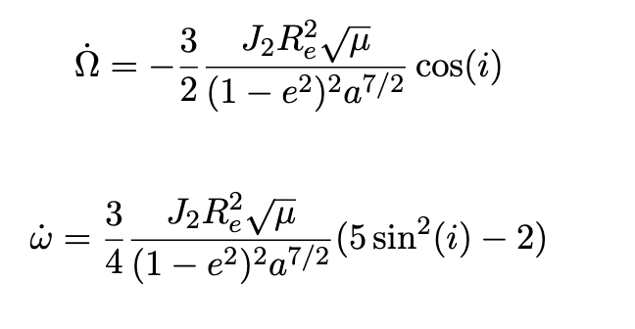
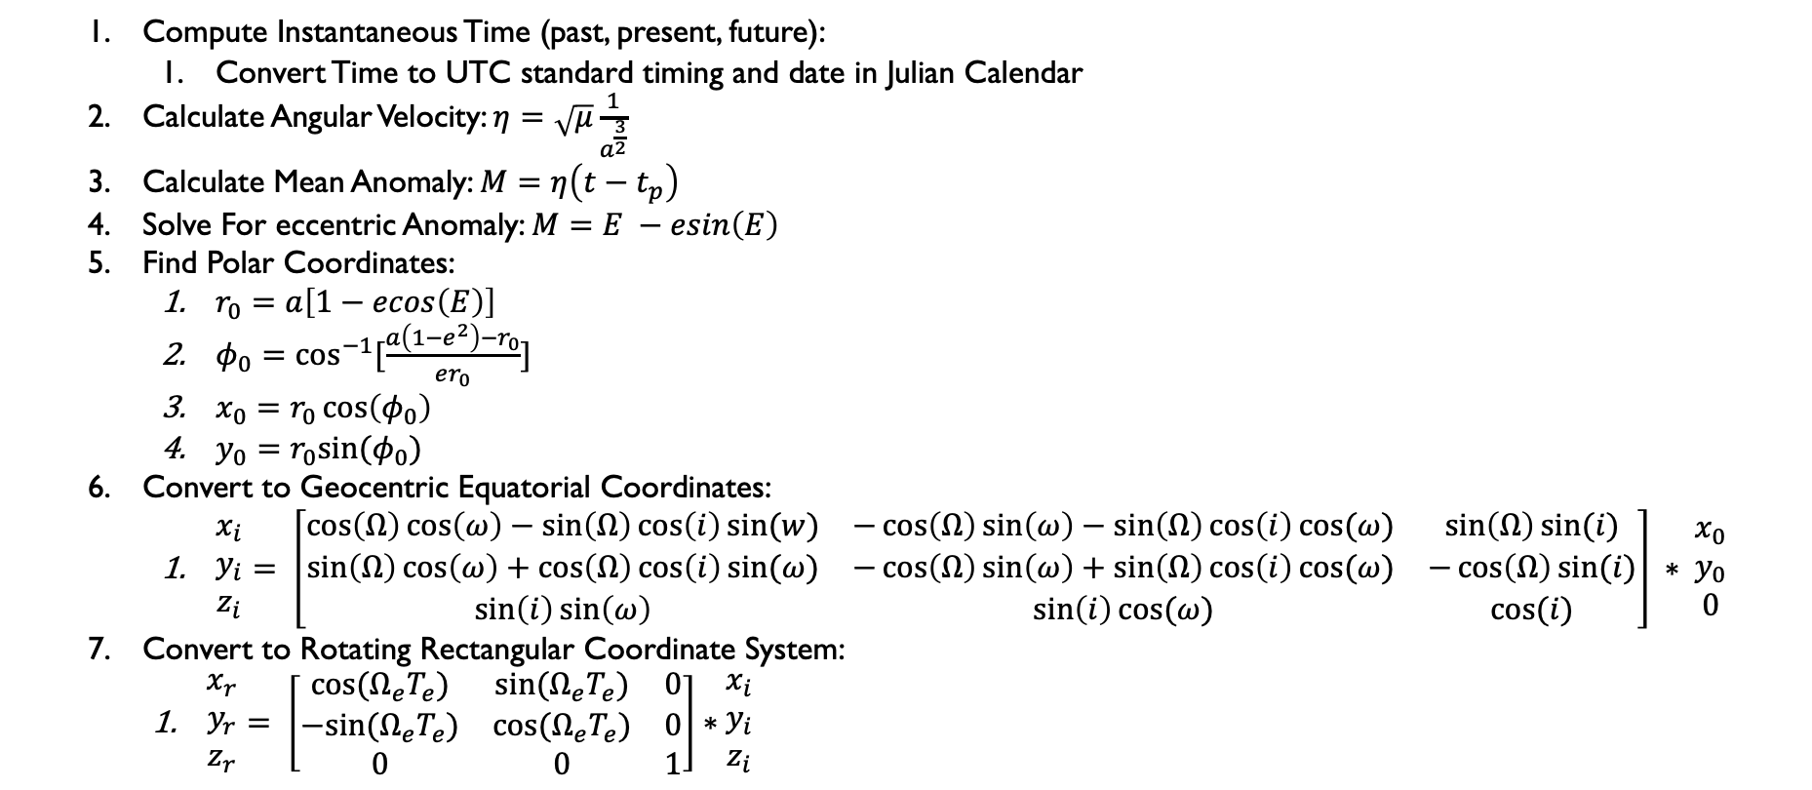
Satellite Tracking
Medium Access Channel (MAC) Protocol
Compute Instantaneous Time (past, present, future):
Convert Time to UTC standard timing and date in Julian Calendar
Calculate Angular Velocity: $η=\sqrt{μ}\frac{1}{a^{\frac{3}{2}}}$
Calculate Mean Anomaly: $M=η\left(t−t_{p}\right)$
Solve For eccentric Anomaly: $M=E −esin\left(E\right)$
Find Polar Coordinates:
$r_{0}=a\left[1−ecos\left(E\right)\right]$
$φ_{0}=\cos^{−1}{[\frac{a\left(1−e^{2}\right)−r_{0}}{er_{0}}]}$
$x_{0}=r_{0}\cos\left(φ_{0}\right)$
$y_{0}=r_{0}sin⁡(φ_{0})$
Convert to Geocentric Equatorial Coordinates:
$\begin{matrix}x_{i} \\ y_{i} \\ z_{i}\end{matrix}= \left[\begin{matrix}\cos\left(Ω\right)\cos\left(ω\right)−\sin\left(Ω\right)\cos\left(i\right)sin⁡(w) & −\cos\left(Ω\right)\sin\left(ω\right)−\sin\left(Ω\right)\cos\left(i\right)cos⁡(ω) & \sin\left(Ω\right)sin⁡(i) \\ \sin\left(Ω\right)\cos\left(ω\right)+\cos\left(Ω\right)\cos\left(i\right)sin⁡(ω) & −\cos\left(Ω\right)\sin\left(ω\right)+\sin\left(Ω\right)\cos\left(i\right)cos⁡(ω) & −\cos\left(Ω\right)sin⁡(i) \\ \sin\left(i\right)\sin\left(ω\right) & \sin\left(i\right)cos⁡(ω) & cos⁡(i)\end{matrix}\right] ∗ \begin{matrix}x_{0} \\ y_{0} \\ 0\end{matrix}$
Convert to Rotating Rectangular Coordinate System:
$\begin{matrix}x_{r} \\ y_{r} \\ z_{r}\end{matrix}= \left[\begin{matrix}cos⁡(Ω_{e}T_{e}) & sin⁡(Ω_{e}T_{e}) & 0 \\ −sin⁡(Ω_{e}T_{e}) & cos⁡(Ω_{e}T_{e}) & 0 \\ 0 & 0 & 1\end{matrix}\right]∗\begin{matrix}x_{i} \\ y_{i} \\ z_{i}\end{matrix}$
RFSoC: ZU28DR GEN 1
Technology
16-nm FinFET
Sub-THz Software-Defined Radio (SDR) Implementation
RF
8 DACs , 8 ADCs
Alternative
JESD to Ext.
Programmable Logic
DSP{4K}, LUTS{930k}
Processing System
ARM A53, ARM R5
Application
mmWave
Digital / Analog Hybrid Solution
8/10/20 GHz Options
Notes:
Mu: kepplers constant

Slide 9
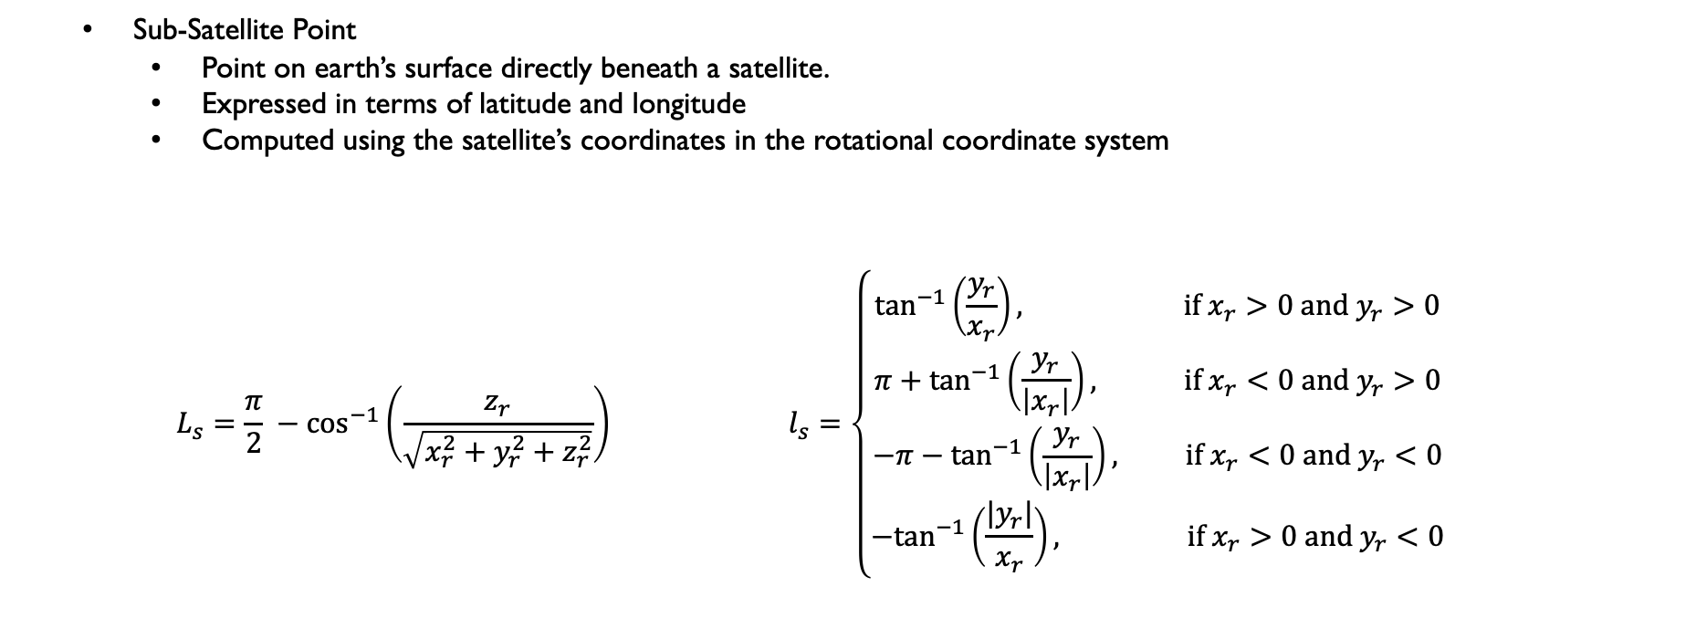
Computing SSP
Medium Access Channel (MAC) Protocol
Sub-Satellite Point
Point on earth’s surface directly beneath a satellite.
Expressed in terms of latitude and longitude
Computed using the satellite’s coordinates in the rotational coordinate system
$$L_{s}=\frac{π}{2} −\cos^{−1}\left(\frac{z_{r}}{\sqrt{x_{r}^{2}+y_{r}^{2}+z_{r}^{2}}}\right) l_{s}=\left\{\begin{aligned}\tan^{−1}\left(\frac{y_{r}}{x_{r}}\right), \text{if} x_{r}>0 \text{and} y_{r}>0 \\ π+\tan^{−1}\left(\frac{y_{r}}{\left|x_{r}\right|}\right), \text{if} x_{r}<0 \text{and} y_{r}>0 \\ −π−\tan^{−1}\left(\frac{y_{r}}{\left|x_{r}\right|}\right), \text{if} x_{r}<0 \text{and} y_{r}<0 \\ {−tan}^{−1}\left(\frac{{|y}_{r}|}{x_{r}}\right), \text{if} x_{r}>0 \text{and} y_{r}<0\end{aligned}\right.$$
RFSoC: ZU28DR GEN 1
Technology
16-nm FinFET
Sub-THz Software-Defined Radio (SDR) Implementation
RF
8 DACs , 8 ADCs
Alternative
JESD to Ext.
Programmable Logic
DSP{4K}, LUTS{930k}
Processing System
ARM A53, ARM R5
Latitude
Application
mmWave
Digital / Analog Hybrid Solution
8/10/20 GHz Options
Longitude
Notes:
Mu: kepplers constant

Slide 10
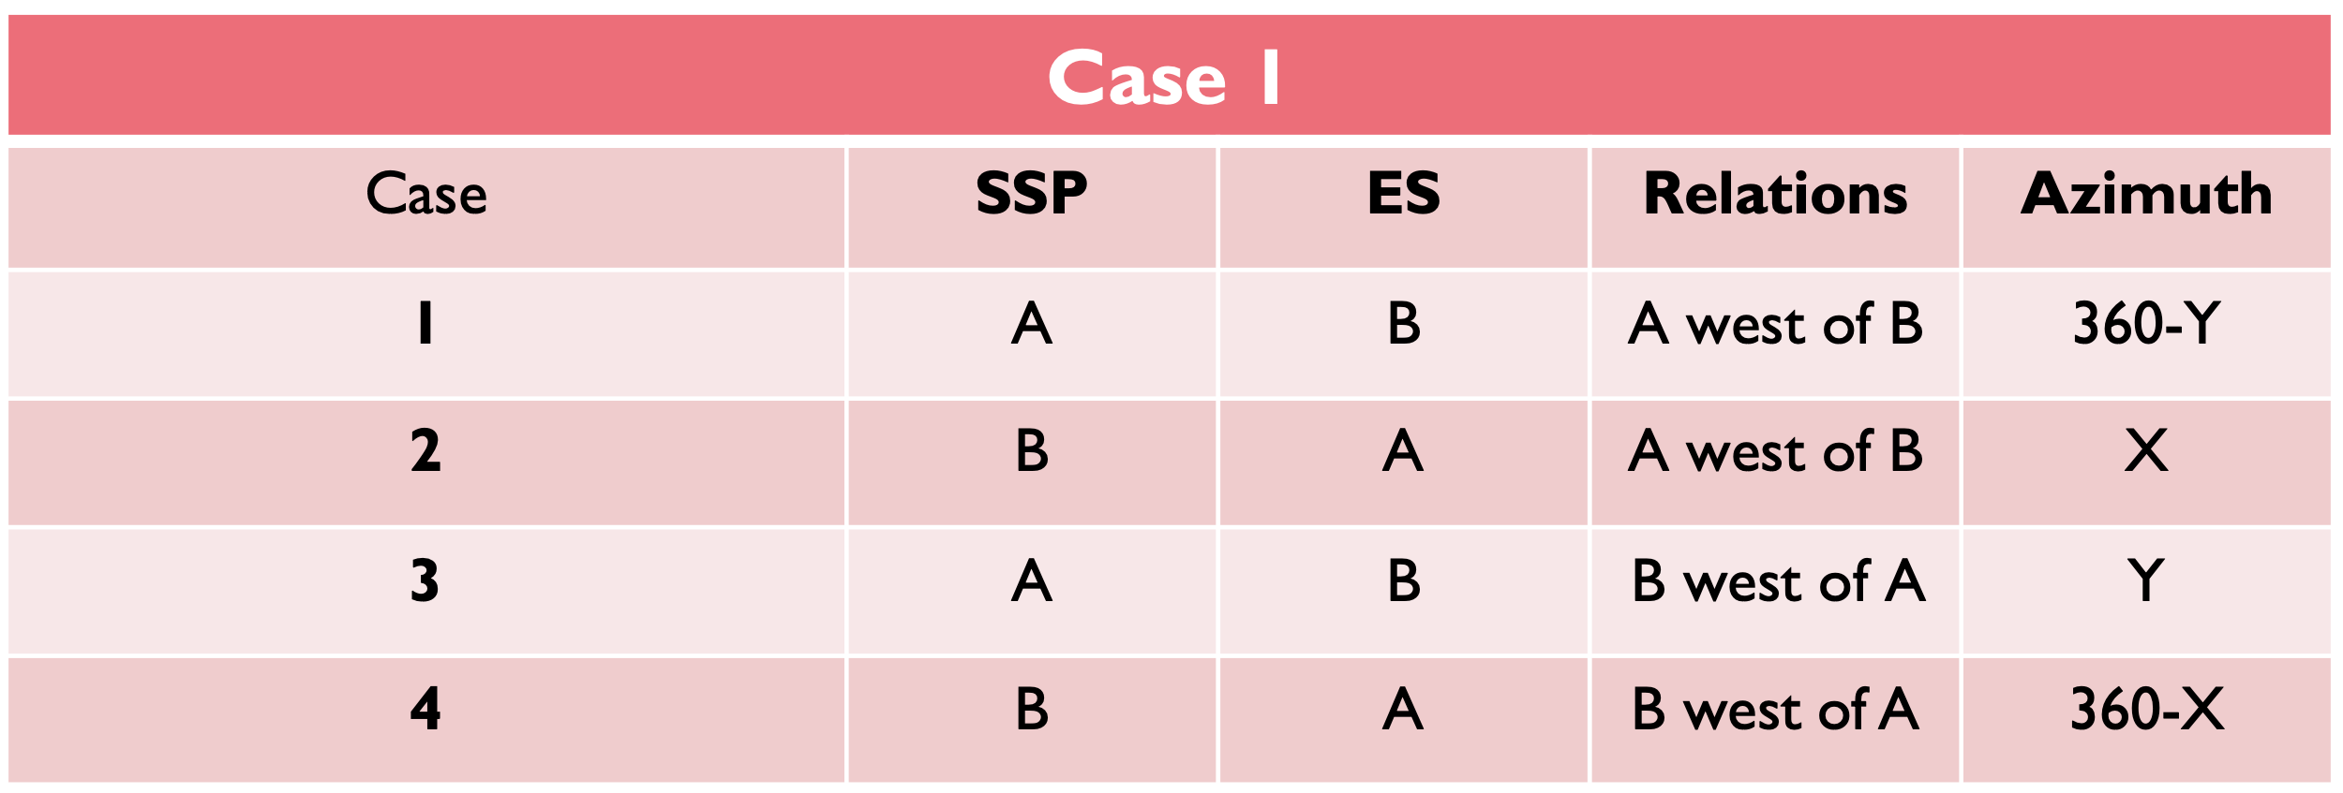
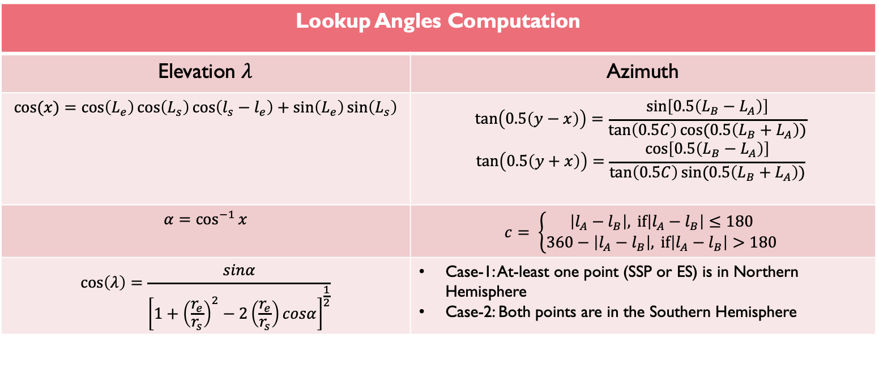
Lookup Angles
Medium Access Channel (MAC) Protocol
Elevation & Azimuth Angle:
Needed for pointing the Ground Station to target Satellite (UL & DL)
Used for computing path loss
RFSoC: ZU28DR GEN 1
Lookup Angles Computation
Elevation $λ$ | Azimuth
$$cos(x)=\cos\left(L_{e}\right)\cos\left(L_{s}\right)\cos\left(l_{s}−l_{e}\right)+\sin\left(L_{e}\right)\sin\left(L_{s}\right)$$ | $$\tan\left(0.5\left(y−x\right)\right)=\frac{\sin\left[0.5\left(L_{B}−L_{A}\right)\right]}{\tan\left(0.5C\right)cos⁡(0.5\left(L_{B}+L_{A}\right))}$$ $$\tan\left(0.5\left(y+x\right)\right)=\frac{\cos\left[0.5\left(L_{B}−L_{A}\right)\right]}{\tan\left(0.5C\right)sin⁡(0.5\left(L_{B}+L_{A}\right))}$$
$$α=\cos^{−1}{x}$$ | $$c= \left\{\begin{aligned}\left|l_{A}−l_{B}\right|, \text{if}\left|l_{A}−l_{B}\right|≤180 \\ 360−\left|l_{A}−l_{B}\right|, \text{if}\left|l_{A}−l_{B}\right|>180\end{aligned}\right.$$
$$\cos\left(λ\right)=\frac{sinα}{{\left[1+{\left(\frac{r_{e}}{r_{s}}\right)}^{2}−2\left(\frac{r_{e}}{r_{s}}\right)cosα\right]}^{\frac{1}{2}}}$$ | Case-1: At-least one point (SSP or ES) is in Northern Hemisphere Case-2: Both points are in the Southern Hemisphere
Technology
16-nm FinFET
Sub-THz Software-Defined Radio (SDR) Implementation
RF
8 DACs , 8 ADCs
Alternative
JESD to Ext.
Programmable Logic
DSP{4K}, LUTS{930k}
Processing System
ARM A53, ARM R5
Application
mmWave
Digital / Analog Hybrid Solution
8/10/20 GHz Options
Notes:
Re_ radius of earth
R_s – distance to satellite

Slide 11
Channel Model
Medium Access Channel (MAC) Protocol
The values for the absorption losses are obtained from the ITU Recommendation ITU-R P.676-12 as well as Recommendation ITU-R P.835.
RFSoC: ZU28DR GEN 1
Select Source GS
Get latitude, longitude, and altitude of GS
Compute Potential Satellites in the FOV of GS [Visibility Test]
Select Satellite With Shortest Distance to GS
Technology
16-nm FinFET
Sub-THz Software-Defined Radio (SDR) Implementation
RF
8 DACs , 8 ADCs
Alternative
JESD to Ext.
Compute Molecular Based Attenuation and Spreading Loss
Compute Atmospheric Profile Using P.835 or Use API Call to Retrieve Accurate Atmospheric Profile of GS at Time (t) (Supported Functionality in weather.py – API Key Provided)
Using Computed Satellite SSP at Time (t) Compute GS Inclination Angle
Programmable Logic
DSP{4K}, LUTS{930k}
Processing System
ARM A53, ARM R5
Application
mmWave
Digital / Analog Hybrid Solution
8/10/20 GHz Options
Notes:
Mu: kepplers constant

Slide 12
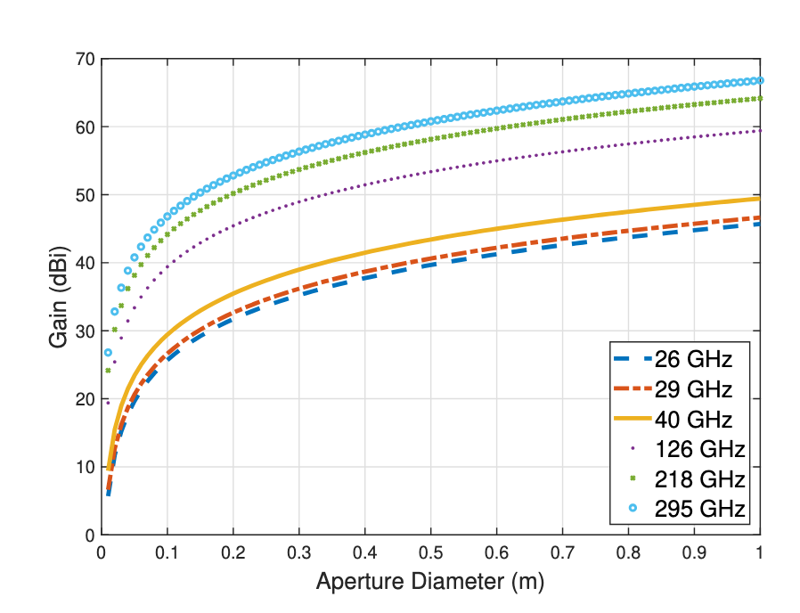
Link Budget
Medium Access Channel (MAC) Protocol
Highest Achievable Modulation Scheme Given ${10}^{−6}$ BER
THz Band
 | UL | DL | CL
Frequency [GHz] | 217.5 | 295 | 295
Bandwidth [GHz] | 17 | 40 | 40
Satellite Gain [dBi] | 45 | 48 | 48
Terminal Gain [dBi] | 49 | 72 | -
TX Power [mW] | 200 | 200 | 200
RFSoC: ZU28DR GEN 1
Technology
16-nm FinFET
Sub-THz Software-Defined Radio (SDR) Implementation
RF
8 DACs , 8 ADCs
Alternative
JESD to Ext.
Programmable Logic
DSP{4K}, LUTS{930k}
Ka Band
 | UL | DL | CL
Frequency [GHz] | 28.75 | 40 | 26.375
Bandwidth [GHz] | 2.5 | 5 | 2.25
Satellite Gain [dBi] | 28 | 30 | 27
Terminal Gain [dBi] | 52 | 54 | -
TX Power [mW] | 5000 | 5000 | 5000
Processing System
ARM A53, ARM R5
Application
mmWave
Digital / Analog Hybrid Solution
8/10/20 GHz Options
Notes:
Mu: kepplers constant

Slide 13
Routing
Medium Access Channel (MAC) Protocol
To fully capture network performance, latency needs to be computed
A routing protocol needs to be programmed in the simulation
Not many options were available
Most routing protocols are proprietary (ex. Starlink)
Our base routing model was a simple shortest first hop algorithm
The first satellite is picked based on shortest distance to source ground station
The last satellite is picked based on shortest distance to target ground station
Each hop needs to move in the direction towards destination
With mega-constellations, there will be numerous options to pick in the cross-link
Methodologies:
Pick the shortest-range hop to maximize data-rate
Could lead to zig-zag pattern and not a “straight path” to destination
Pick the longest-range hop to minimize overall latency and route distance
Might reduce the MCS leading to a higher transmission time
Process:
Select UL and DL Satellite
At each hop:
Conduct visibility test (SAT to SAT)
Conduct LB test
Select longest range hop in the direction of destination
RFSoC: ZU28DR GEN 1
Technology
16-nm FinFET
Sub-THz Software-Defined Radio (SDR) Implementation
RF
8 DACs , 8 ADCs
Alternative
JESD to Ext.
Programmable Logic
DSP{4K}, LUTS{930k}
Processing System
ARM A53, ARM R5
Application
mmWave
Digital / Analog Hybrid Solution
8/10/20 GHz Options
Notes:
Mu: kepplers constant

Slide 14
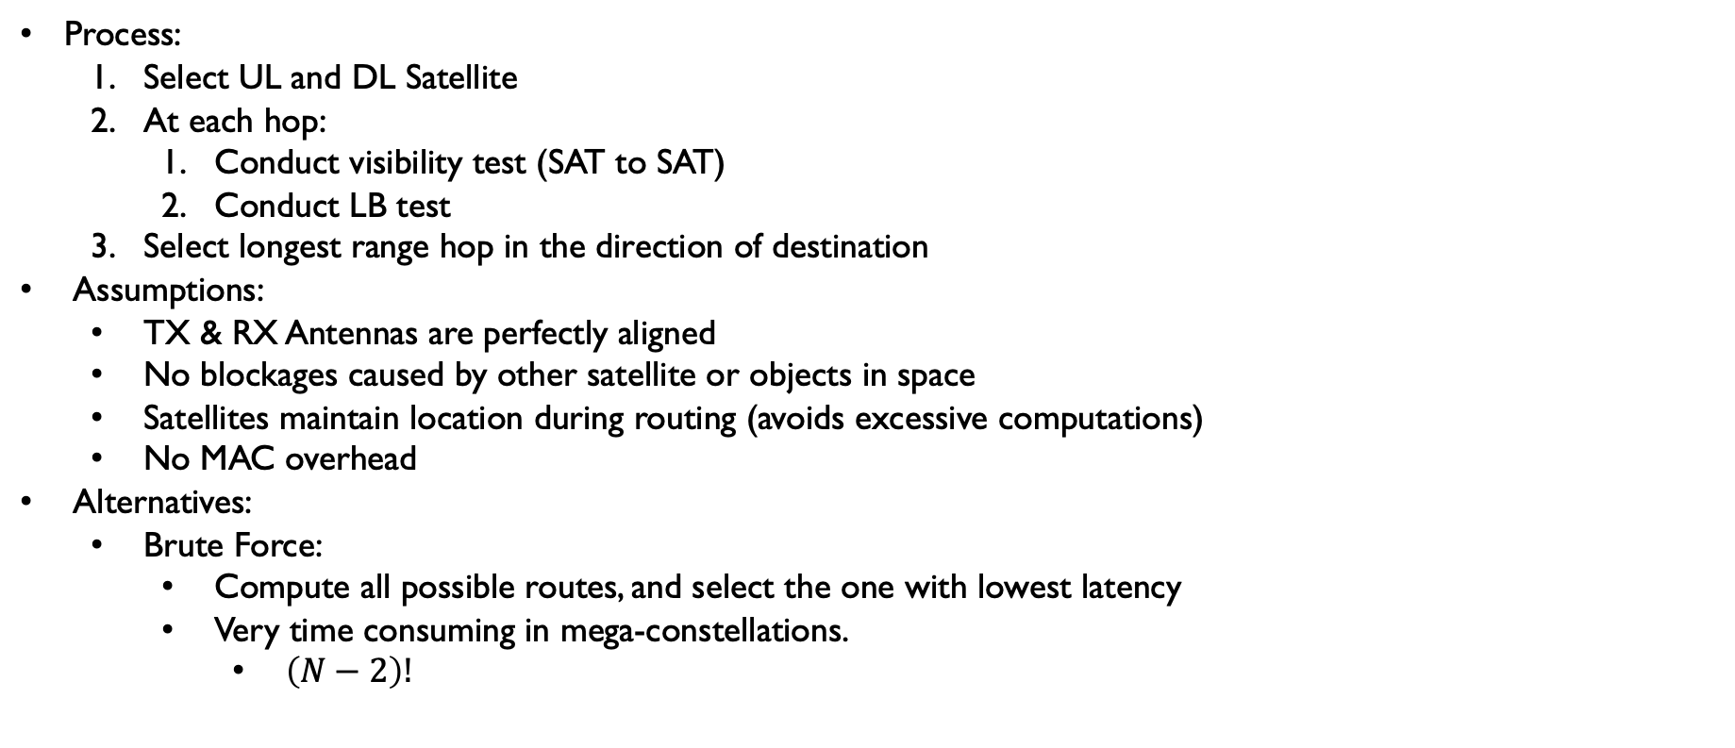
Routing
Medium Access Channel (MAC) Protocol
Process:
Select UL and DL Satellite
At each hop:
Conduct visibility test (SAT to SAT)
Conduct LB test
Select longest range hop in the direction of destination
Assumptions:
TX & RX Antennas are perfectly aligned
No blockages caused by other satellite or objects in space
Satellites maintain location during routing (avoids excessive computations)
No MAC overhead
Alternatives:
Brute Force:
Compute all possible routes, and select the one with lowest latency
Very time consuming in mega-constellations.
$\left(N−2\right)!$
RFSoC: ZU28DR GEN 1
Technology
16-nm FinFET
Sub-THz Software-Defined Radio (SDR) Implementation
RF
8 DACs , 8 ADCs
Alternative
JESD to Ext.
Programmable Logic
DSP{4K}, LUTS{930k}
Processing System
ARM A53, ARM R5
Application
mmWave
Digital / Analog Hybrid Solution
8/10/20 GHz Options
Notes:
Mu: kepplers constant

Slide 15
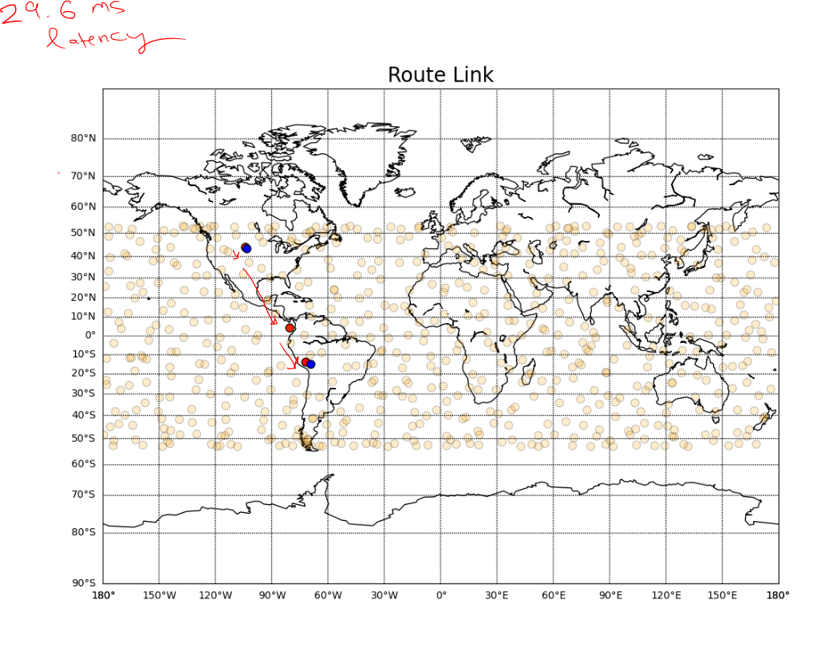
Routing
Medium Access Channel (MAC) Protocol
RFSoC: ZU28DR GEN 1
Technology
16-nm FinFET
Sub-THz Software-Defined Radio (SDR) Implementation
RF
8 DACs , 8 ADCs
Alternative
JESD to Ext.
Programmable Logic
DSP{4K}, LUTS{930k}
Processing System
ARM A53, ARM R5
Application
mmWave
Digital / Analog Hybrid Solution
8/10/20 GHz Options
Mega-Constellation: 3-Hop Relay (29.6ms latency)
Notes:
Mu: kepplers constant

Slide 16
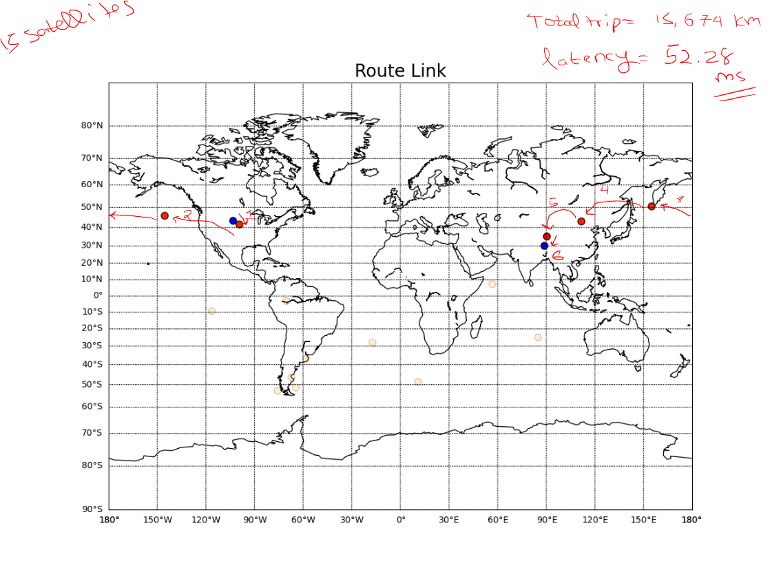
Routing
Medium Access Channel (MAC) Protocol
RFSoC: ZU28DR GEN 1
Technology
16-nm FinFET
Sub-THz Software-Defined Radio (SDR) Implementation
RF
8 DACs , 8 ADCs
Alternative
JESD to Ext.
Programmable Logic
DSP{4K}, LUTS{930k}
Processing System
ARM A53, ARM R5
Application
mmWave
Digital / Analog Hybrid Solution
8/10/20 GHz Options
15 Satellites: 3-Hop Relay (52.3 ms latency)
Notes:
Mu: kepplers constant

Slide 17
Simulation Ecosystem
Medium Access Channel (MAC) Protocol
To compare THz and KA performance, we ran a simulation:
Transmission times are modeled as Poisson Process
Simulation time duration is set to 4 hours
The source and destination ground stations are picked at random from a list of 11 cities
Ex: Fresno-California, Raleigh-North Carolina, Moscow-Russia, Izmir-Turkey, Nairobi-Kenya, …
The elevation of these cities are taken into account during the path-loss calculation.
Number of Satellites: ~4000 [custom built constellations – supported by simulator]
Satellite Altitude: 300km
RFSoC: ZU28DR GEN 1
Technology
16-nm FinFET
Sub-THz Software-Defined Radio (SDR) Implementation
RF
8 DACs , 8 ADCs
Alternative
JESD to Ext.
Programmable Logic
DSP{4K}, LUTS{930k}
Processing System
ARM A53, ARM R5
Application
mmWave
Digital / Analog Hybrid Solution
8/10/20 GHz Options
Notes:
Mu: kepplers constant

Slide 18
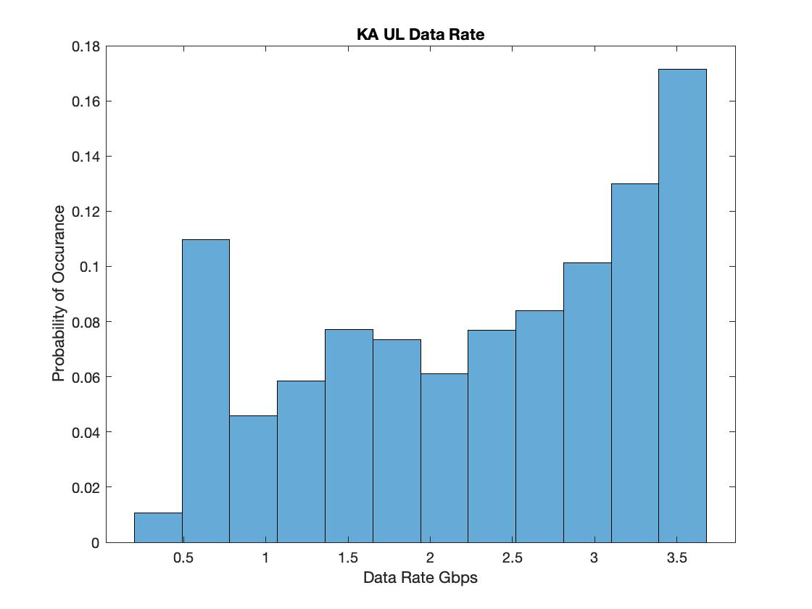
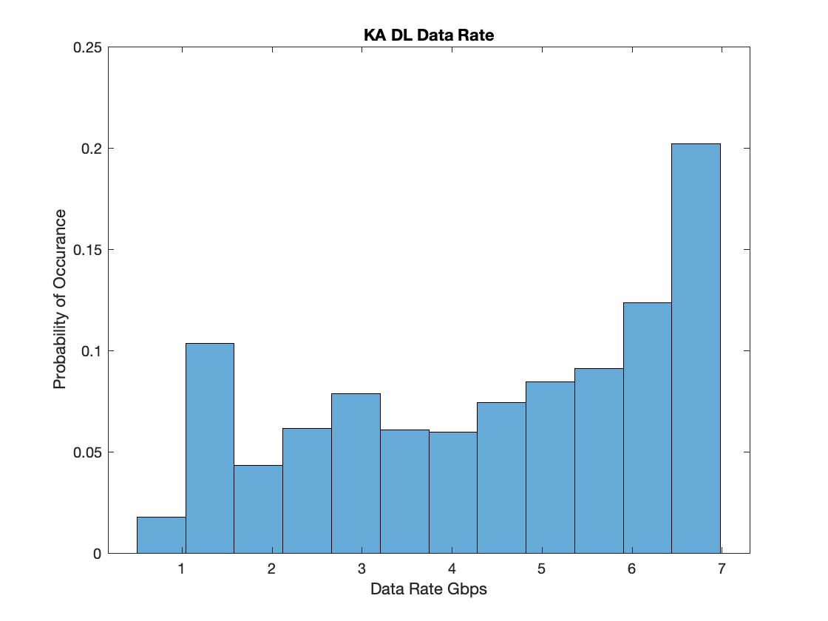
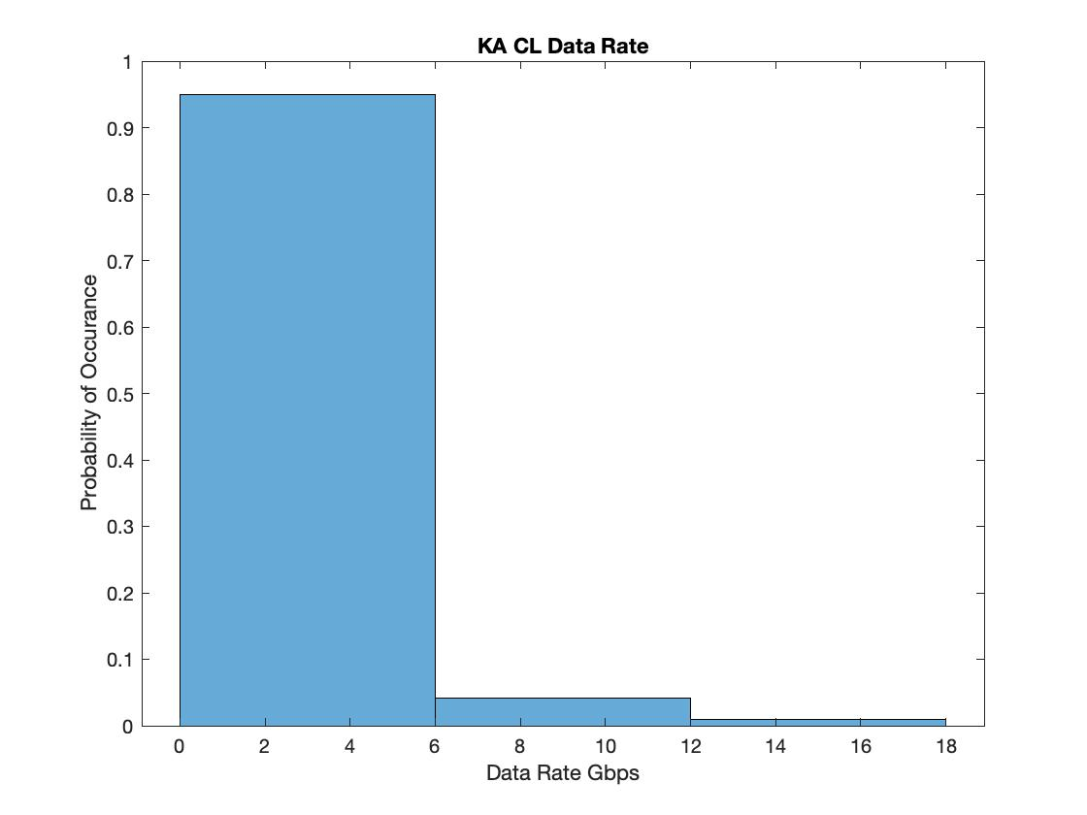
Results: KA Band
Medium Access Channel (MAC) Protocol
RFSoC: ZU28DR GEN 1
Technology
16-nm FinFET
Sub-THz Software-Defined Radio (SDR) Implementation
RF
8 DACs , 8 ADCs
Alternative
JESD to Ext.
Programmable Logic
DSP{4K}, LUTS{930k}
Processing System
ARM A53, ARM R5
Application
mmWave
Digital / Analog Hybrid Solution
8/10/20 GHz Options
Notes:
Mu: kepplers constant

Slide 19
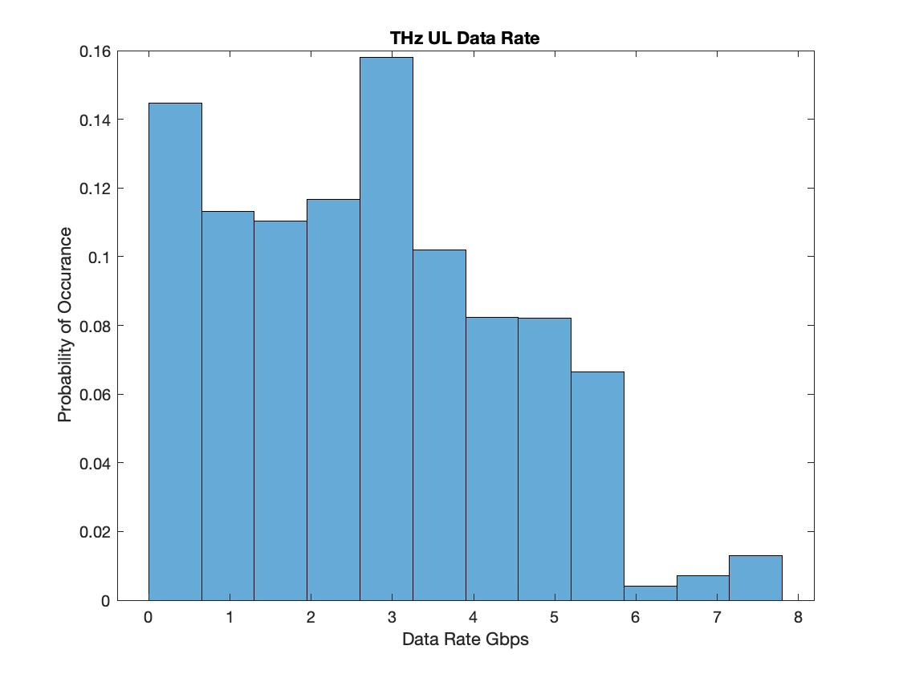
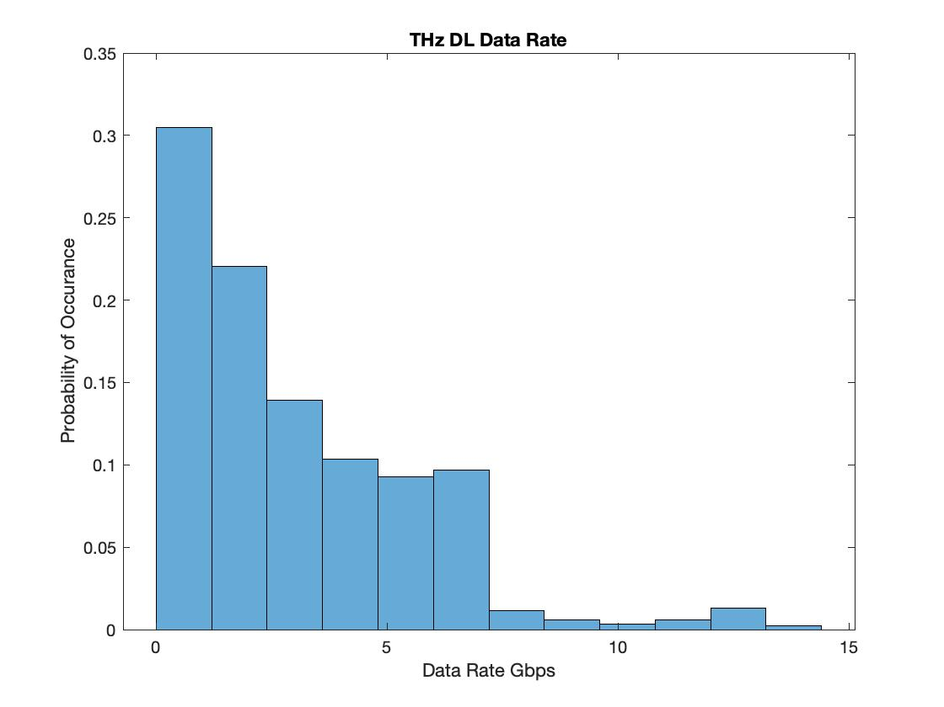
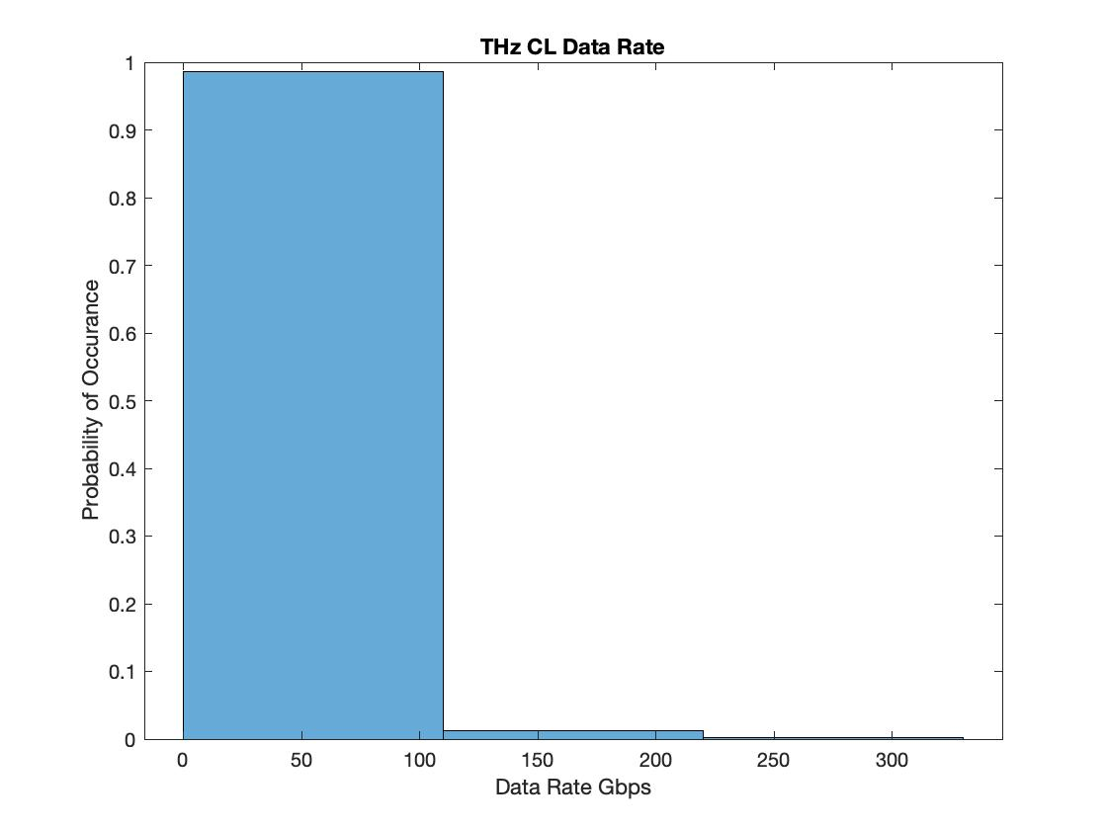
Results: THz Band
Medium Access Channel (MAC) Protocol
RFSoC: ZU28DR GEN 1
Technology
16-nm FinFET
Sub-THz Software-Defined Radio (SDR) Implementation
RF
8 DACs , 8 ADCs
Alternative
JESD to Ext.
Programmable Logic
DSP{4K}, LUTS{930k}
Processing System
ARM A53, ARM R5
Application
mmWave
Digital / Analog Hybrid Solution
8/10/20 GHz Options
Notes:
Mu: kepplers constant

Slide 20
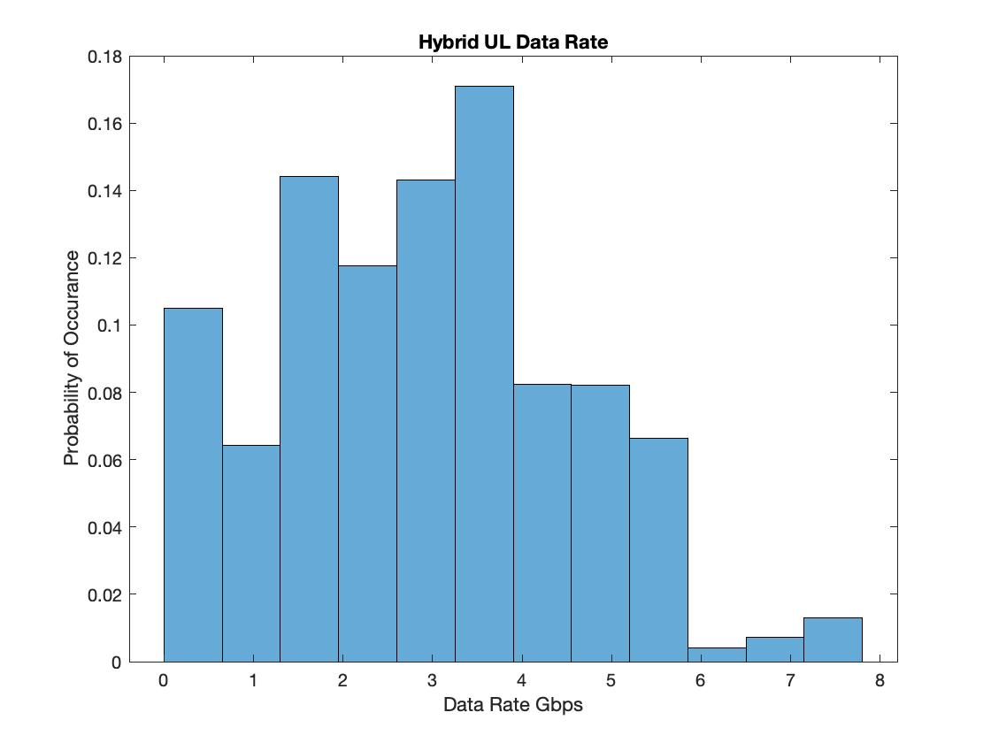
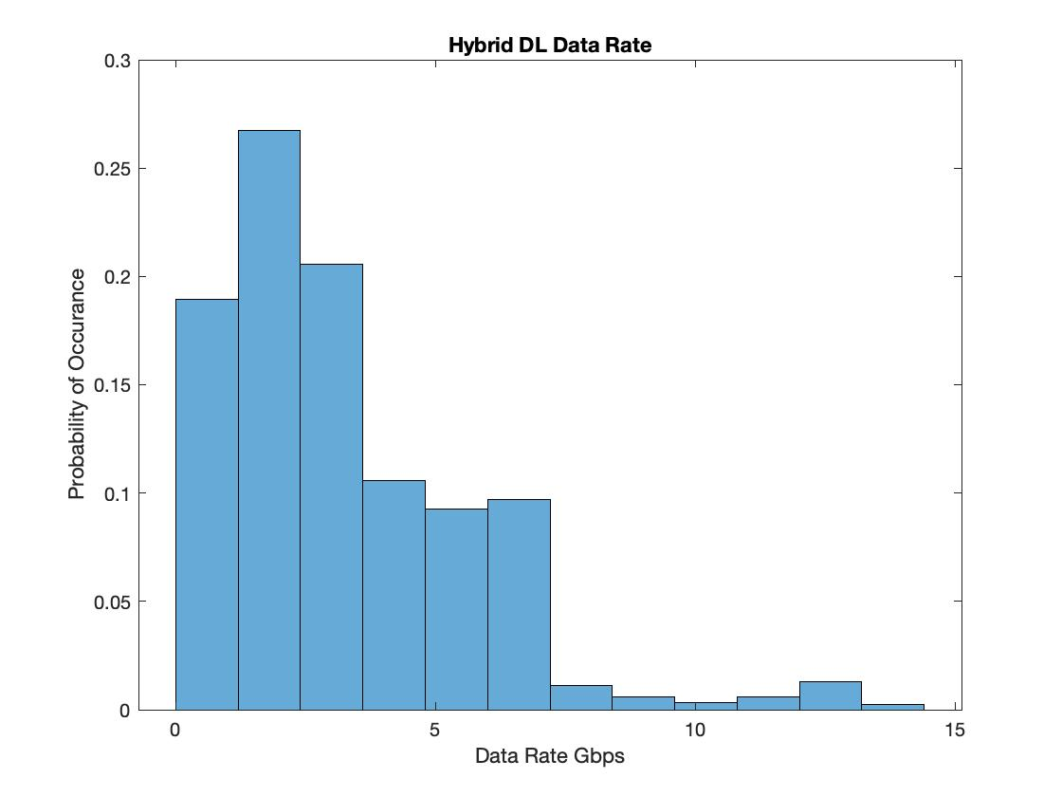
Results: Hybrid
Medium Access Channel (MAC) Protocol
RFSoC: ZU28DR GEN 1
Technology
16-nm FinFET
Sub-THz Software-Defined Radio (SDR) Implementation
RF
8 DACs , 8 ADCs
Alternative
JESD to Ext.
Programmable Logic
DSP{4K}, LUTS{930k}
Processing System
ARM A53, ARM R5
Application
mmWave
Digital / Analog Hybrid Solution
8/10/20 GHz Options
Notes:
Mu: kepplers constant

Slide 21
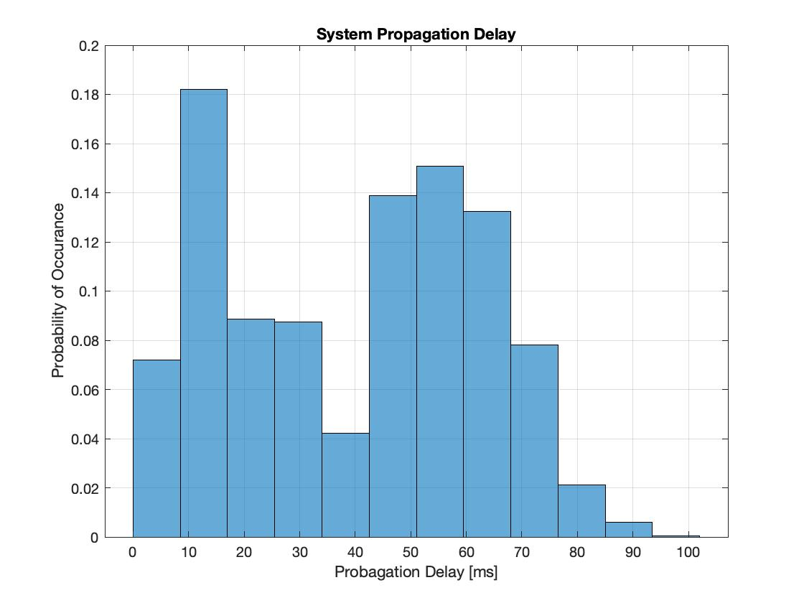
Results: Propagation Delay

Slide 22
Conclusion

